Slide 1
Storyboard A3/5
Team #22

Slide 2
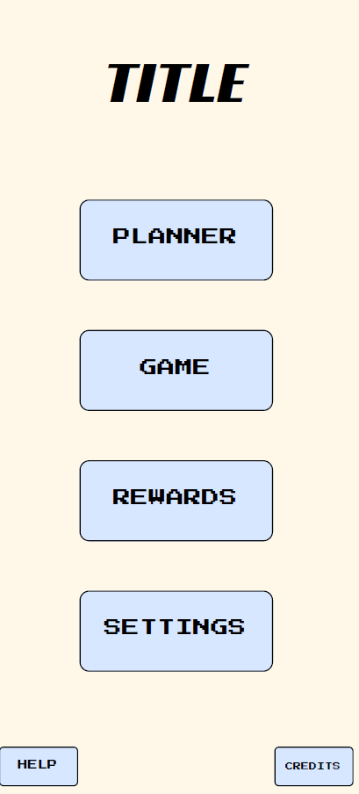
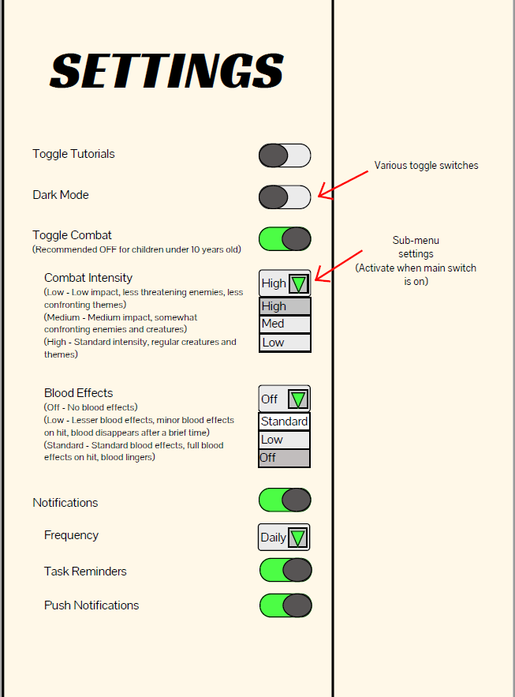
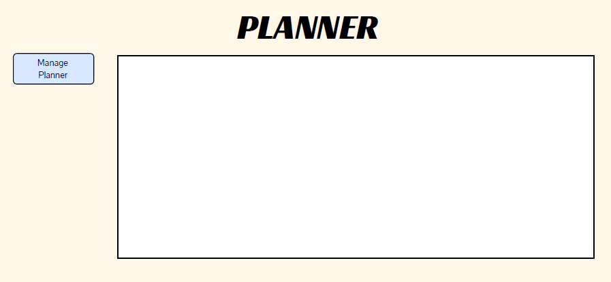
GUI Concept Art
Andrew Designed the concept of our app, a basic user interface for us to work with and something that all users should be able to use with ease.

